Slide 1


Green Pace
Security Policy Presentation
Developer: Jehu Domenech

Slide 2

OVERVIEW: DEFENSE IN DEPTH
With the security policy implemented we are defining core security principles which will ensure quality and standard. By using the Encryption and AAA framework we are looking to keep the standards for security.

Slide 3
THREATS MATRIX
Rules with likelihood of likely and probable where put in the likely section for unlikely it was put accordingly. When setting the priority I checked both the likelihood and severity in account and I set them accordingly. Medium severity with unlikely goes to low priority and medium severity and likely goes into priority.
Likely STR50-CPP MEM50-CPP ERR56-CPP CTR54-CPP EXP53-CPP | Priority STR50-CPP STR53-CPP MEM50-CPP CTR54-CPP ERR56-CPP EXP53-CPP DCL58-CPP
Low priority DCL52-CPP INT50-CPP INT50-CPP | Unlikely DCL52-CPP INT50-CPP STR53-CPP INT50-CPP DCL58-CPP

Slide 4
10 PRINCIPLES
Adopt a Secure Coding Standard
Use Effective Quality Assurance Techniques
Architect and Design for Security Policies
Keep It Simple
Default Deny
Adhere to the Principle of Least Privilege
Practice Defense in Depth
Validate Input Data
Sanitize Data Sent to Other Systems
Heed Compiler Warnings
I went with the following order according to importance. With the order I am looking to build a solid foundation so that the following principles can be implemented easily.

Slide 5
CODING STANDARDS
STR50-CPP
MEM50-CPP
EXP53-CPP
ERR56-CPP
CTR54-CPP
STR53-CPP
DCL58-CPP
INT50-CPP
INT50-CPP
DCL52-CPP
For the order in the coding standards I decided to use the official priority levels used in the coding standards website. They use the likelihood and severity for setting the priority.

Slide 6
ENCRYPTION POLICIES
Encryption at rest looks to encrypt data when it is stored in the system and not moving from system to system.
Encryption at flight encrypts data when it is being sent over from one end to another end.
Encryption in use encrypts data when it is being used on the system.

Slide 7
TRIPLE-A POLICIES
Authentication looks to confirm that the person who is using the system is the person that is supposed to access it. This uses logins and passwords and other security measures that ensure that it is the person.
Authorization lets the user only access what they need to access and nothing else this prevents security vulnerabilities.
Accounting ties the account with each action they do so that they hold accountability for what they do in the system.

Slide 8
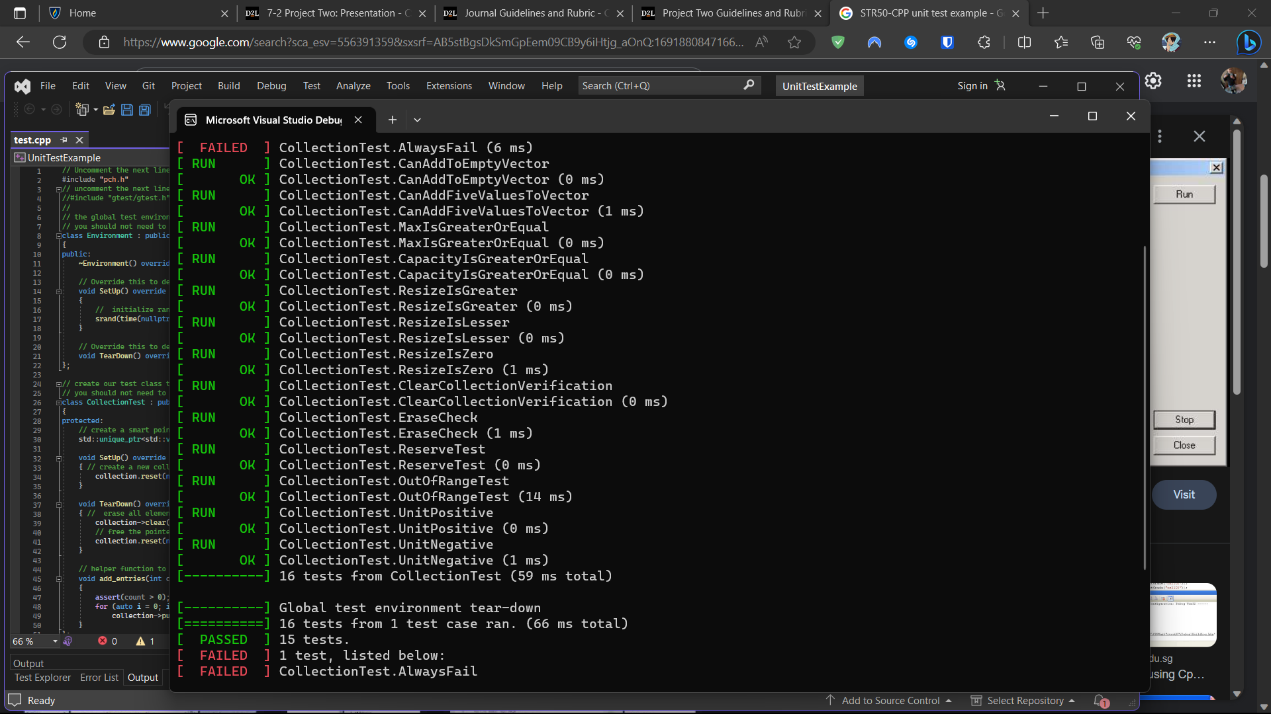
UNIT TESTING
This unit test shows various tests the OutOfRangeTest shows that the exception of std::out_of_range is thrown when the vector is at 20 by using myvector.at(20).

Slide 9

AUTOMATION SUMMARY
When automating by looking at the diagram below we would implement the testing in the verify and test portion of the pre-production section.

Slide 10
TOOLS
The DevSecOps pipeline is useful for programming while having security in mind. If the system that is being worked on relies on security a DevSecOps pipeline would be ideal (What is a DevSecOps pipeline?, 2022).
A useful external tool is Check Point CloudGuard it allows you to prevent threats and automize security. This tool would fall in the monitor and detect section of the DevSecOps.

Slide 11
RISKS AND BENEFITS
If security is implemented from the very beginning issues from security will be minimal although the initial set up will take a long time it is much more beneficial for the project.

Slide 12
RECOMMENDATIONS
I believe that my current security policy has a few gaps that would be better filled with other security policies. Although the policies I chose are useful they don’t have enough severity and likelihood for having them in the security policy.

Slide 13
CONCLUSIONS
Looking over the security policy various improvements could be made by having policies with a higher severity level and likeliness. If these are considered, then by automating the process security will be much better for the system.

Slide 14
REFERENCES
Michali. (2022, September 15). What is a DevSecOps pipeline?. Check Point Software. https://www.checkpoint.com/cyber-hub/cloud-security/devsecops/what-is-a-devsecops-pipeline/

